Slide 1
Self Marketing Tools & strategies for Academic Researchers
Network = ‘net’ work = networth

Slide 2
Best tool is Email signature.
Use it wisely and showcase your status and accomplishment.
Just like CCE added beautiful signature in our emails.

Slide 3
What you will get today
How to develop a digital image and researcher identity that market your accomplishments?
How to increase citation index of published article?
Which social media tools can be helpful?
How to connect necessary apps (FB, LinkedIn, Twitter) and automate sharing (Buffer or Hoot suite)?
How to make personal blog, website and YouTube channel for marketing?

Slide 4
We need to be Resourceful
ORCID (Global Identity)
Academia Edu (Networking & Citation)
Research Gate (Networking & Citation)
Google Scholar (For citation)
Mendeley (For Networking)
Publon (Reviewers Network and Showcase)
Calendely (Appointment Tool)
# on Twitter and Facebook (Networking)
LinkedIn (Networking)
Instagram
YouTube Channel
Zoom cloud meeting app

Slide 5
we need self marketing..☺

Slide 6
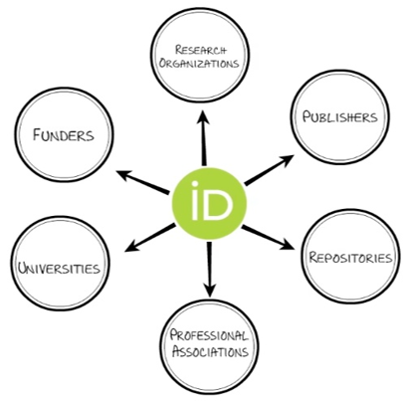
ORCID (Connecting Research and Researchers)
ORCID provides a persistent digital identity that distinguishes you from every other researcher and, through integration in key research workflows such as manuscript (All Springer and world class accept ORCID ID) and grant submission, supports automated linkages between you and your professional activities ensuring that your work is recognized.
https://orcid.org/
Login using Google / Facebook

Slide 7
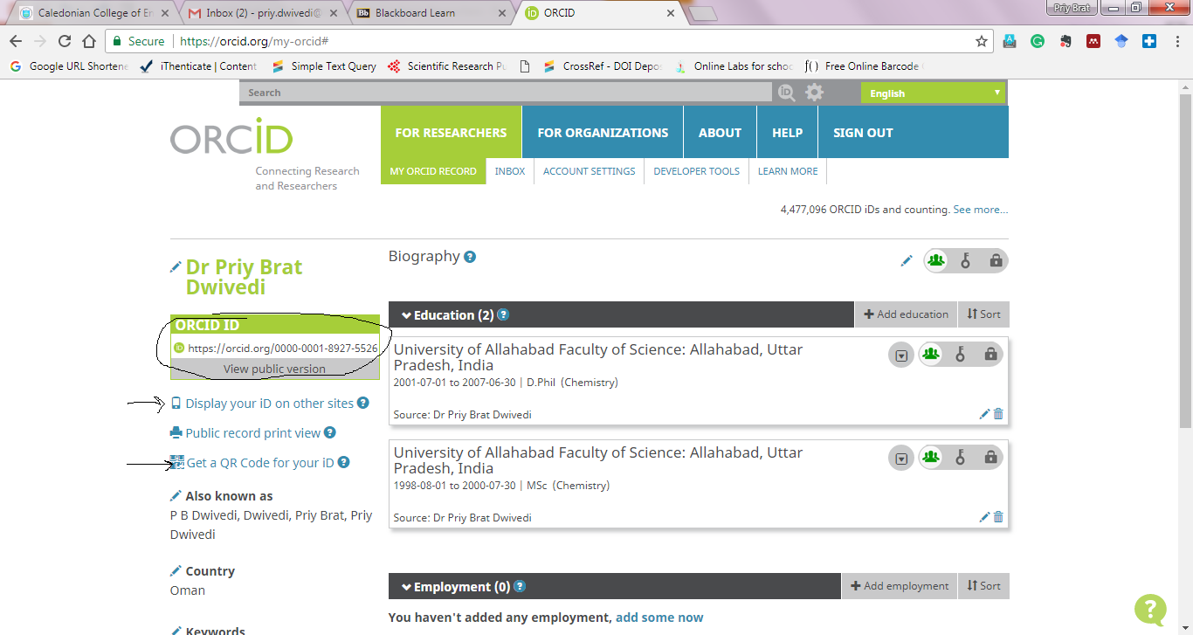

Slide 8
Academia Edu [Share Research]
According to a study by PLOS (Public Library of Science) research shared in Academia Edu collect 69% more citation than other depository.
It is an open-science platform to bring the world's research online, available to all, for free. With over 60 million registered users, Academia is rapidly transforming the way researchers share their work.
A small team of 25 people passionate about building great software to open up science. In 2016 they raised $11 million to fuel the growth of the platform and the team.
Login Google, Facebook

Slide 9
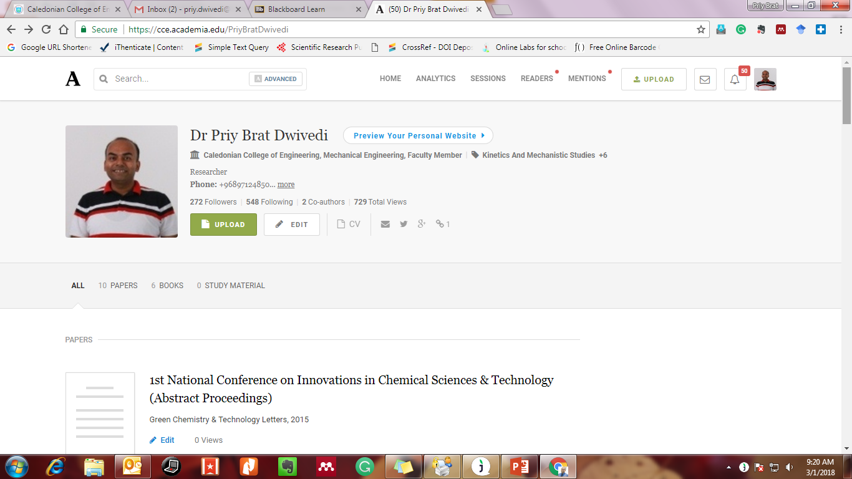
See the impact of research & views

Slide 10
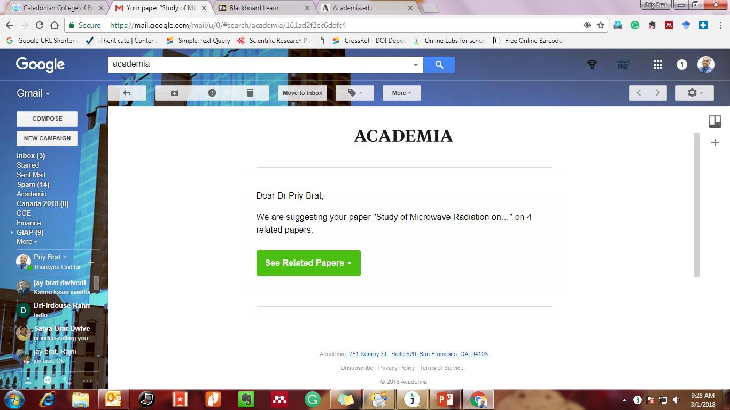
They are doing marketing for our research work

Slide 11
Research Gate
Advance your research (Discover scientific knowledge, and make your research visible)
Academic activities, Networking, Sharing knowledge and research documents.
Upload articles, proceedings, dataset, lecture slides etc.
Research Gate Score [Measure impact of activities done on portal, along-with impact of research articles]
Login LinkedIn, Google Facebook

Slide 12
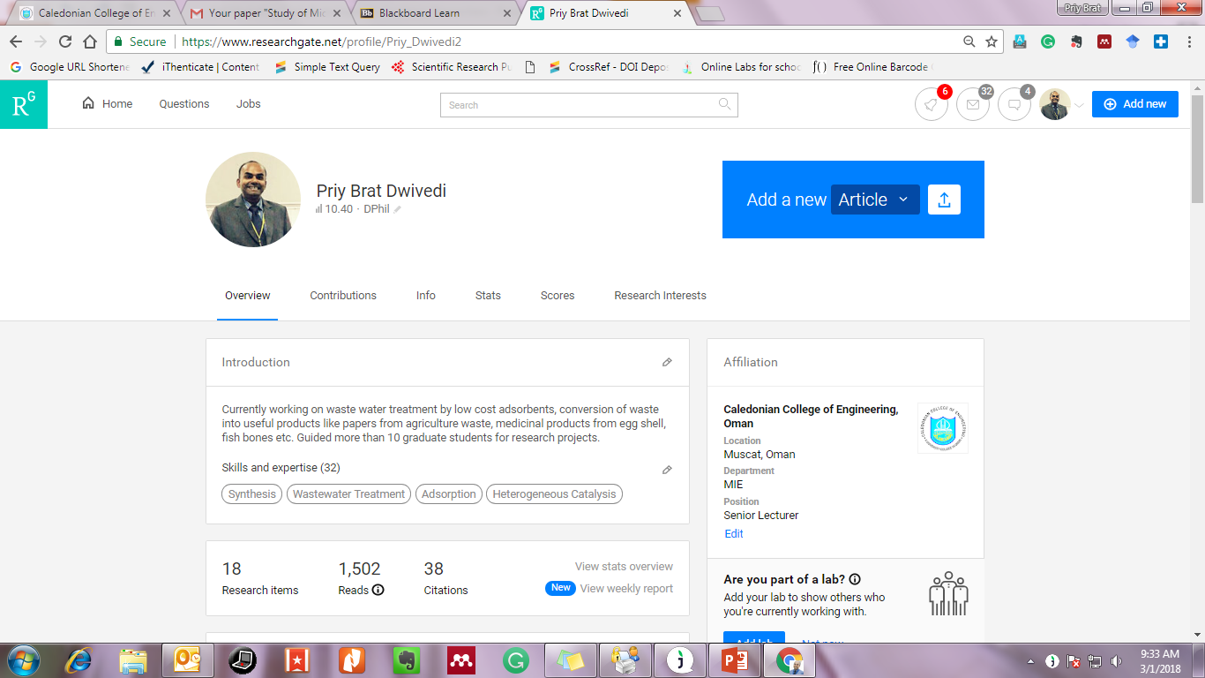

Slide 13
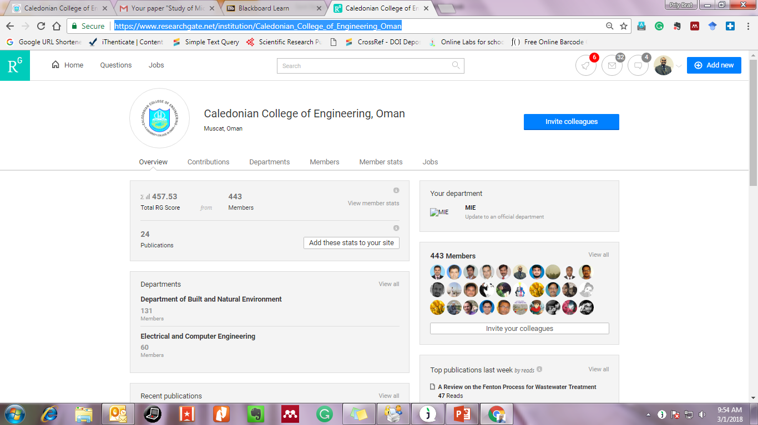
Marketing tool for college

Slide 14
Google Scholar
Provide great insight about citation of published article.
Google Scholar is a freely accessible web search engine that indexes the full text or metadata of scholarly literature across an array of publishing formats and disciplines.
Create account, verify institutional email and be famous.
Google Scholar Citations provide a simple way for authors to keep track of citations to their articles. You can check who is citing your publications, graph citations over time, and compute several citation metrics.
Citation metrics are computed and updated automatically as Google Scholar finds new citations to your work on the web.

Slide 15
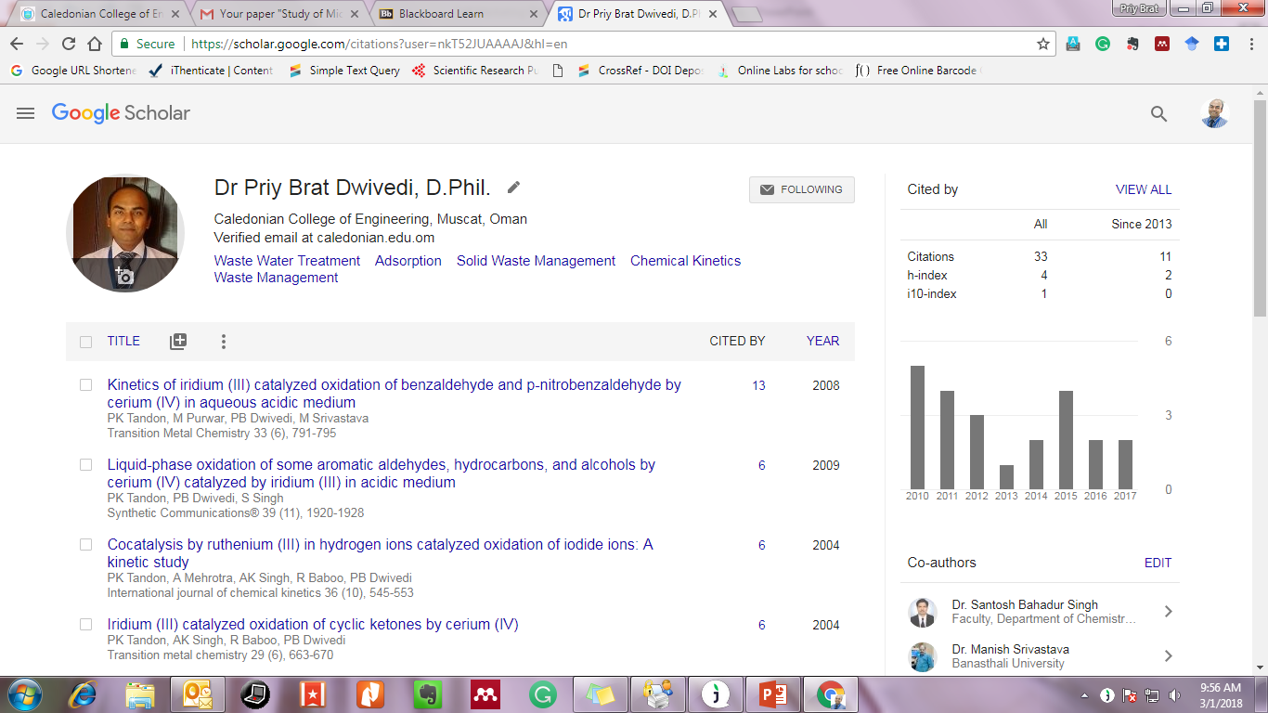

Slide 16
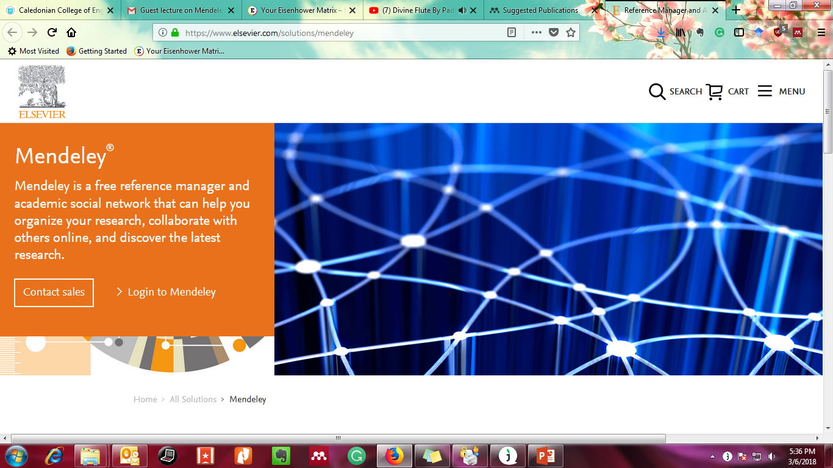
Mendeley

Slide 17
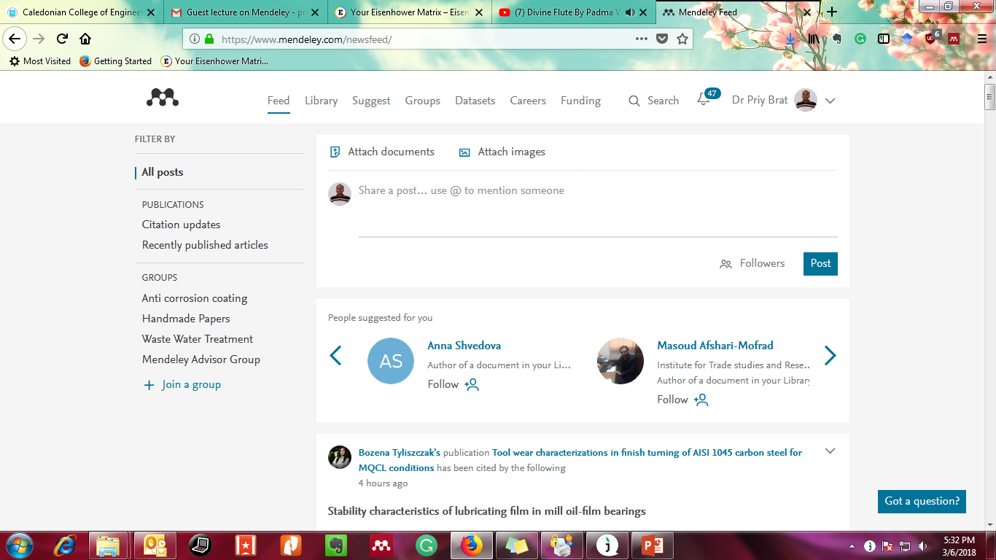
Opportunity to share n showcase

Slide 18
Publon (by clarivate: Company behind TR, WOS etc)
When you do article review, let the whole world know that you did some good reviews for good journal.
Publons is a website and free service for academics to track, verify and showcase their peer reviews and editorial contributions across the world's academic journals.
Make your free account using ORCID, Mendeley, Google, Linkedin.
Excellent connections.

Slide 19
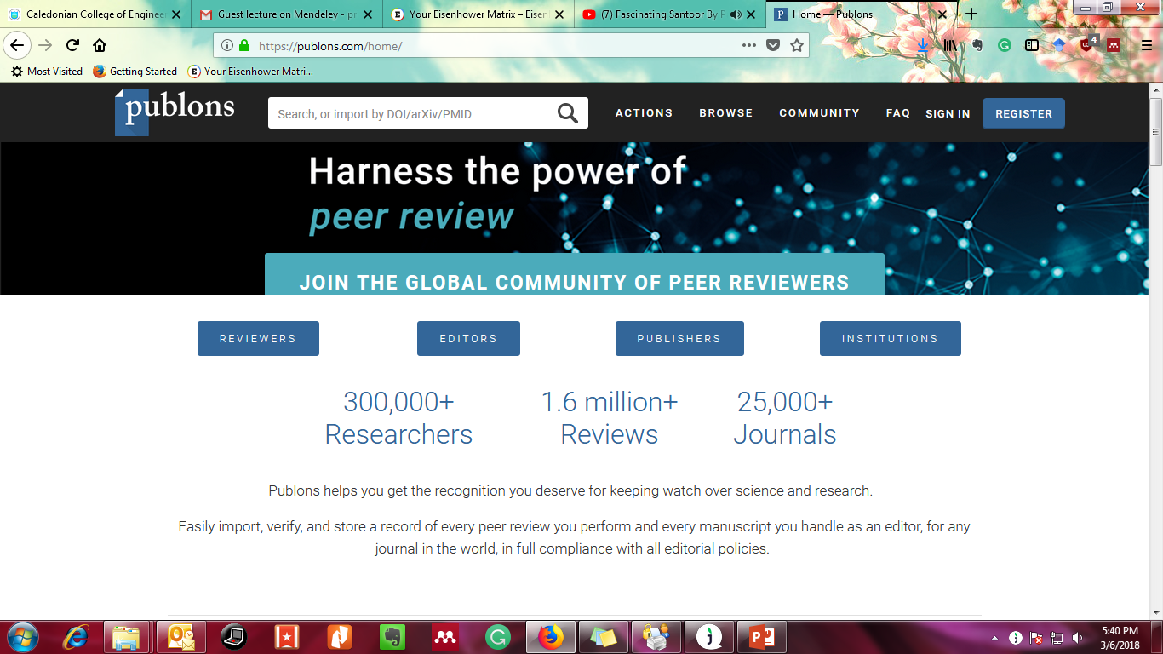

Slide 20
Author AID
AuthorAID is a global network that provides support, mentoring, resources and training for researchers in developing countries.
Good place to find mentors and mentees and spread network in developing countries.
Lots of funding opportunities at http://www.authoraid.info/en/funding/
Free online training courses available on research writing, grant proposal etc.
It’s a project of INASP (International Network for the Availability of Scientific Publications)

Slide 21
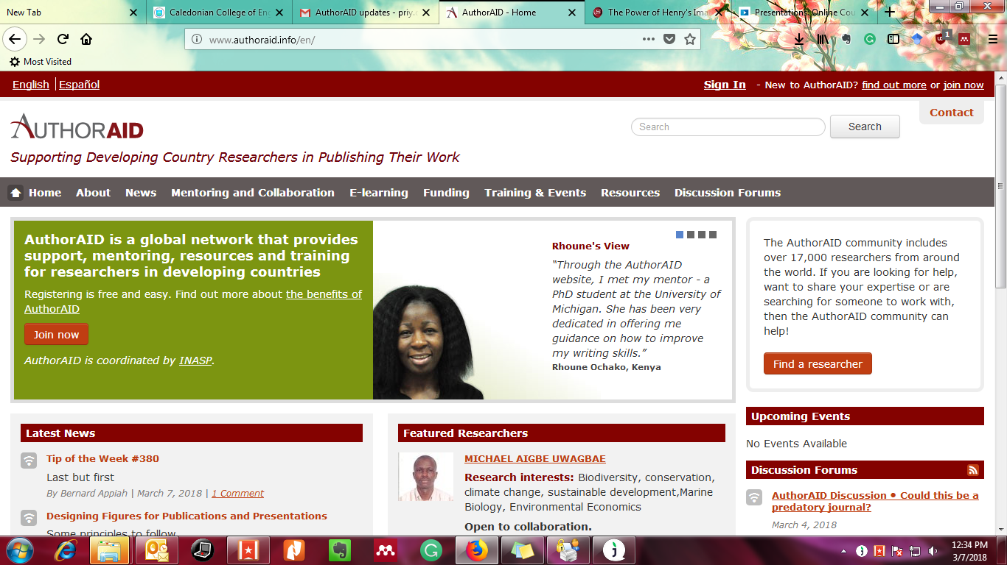

Slide 22
LinkedIn post in home & groups
Opportunity to showcase or share update

Slide 23
Use social media
Post updates related to publication, reviews, academic accomplishments, meeting with leaders, students etc so that people can track your progress.
Use subject related groups in Facebook, LinkedIn, Instagram, What's app etc to promote your accomplishment.
Comment on others works and this way enlarge your circle of influence.
Use trending hashtags (#) on facebook, twitter and instagram to flow with time and trend.
Use hootsuite, buffer, Zapier, IFTTT etc to automate and analyze your social media postings. It save time by automation.
Use Calendely for appointment in signature.
Best tool id Email signature. Use it wisely and showcase your status and accomplishment. Just like CCE added beautiful signature in our emails.

